Slide 1
HDLC & PPP Protocol

Slide 2
Outline
WAN Data Link Layer protocols
HDLC
PPP Protocol
LCP
NCP
PPP Session Establishment Phases
Authentication
PAP
CHAP

Slide 3
WANs
As we have learned, all WAN connections consist of two basic elements:
The physical layer devices and transmission media.
Data-link–layer protocols.
Notes:
The physical layer devices and transmission media: including electrical signaling specifications for generating, transmitting, and receiving signals through various transmission media

Slide 4
WAN Data Link Layer Protocols
WANs require Data Link layer protocols to provide communication between two devices across the communication line.
Because there are many different ways to connect devices, there are many different data link protocols.
Data link protocols may provide any of the following services:
Framing
Session setup and termination
Error detection
Addressing on a multipoint medium
Notes:
The Data Link protocols may span only the local loop, span across regions, or even go intercontinental.
This is unlike the physical layer transmission technologies that are only concerned with moving electrical signals from customer location to the central office for processing.
Framing Data is broken up into frames that are transmitted as independent units. If errors are detected in a frame, it is only necessary to retransmit that frame.
Session setup and termination For reliable services, session control messages are used by end systems to exchange status information about the session.

Slide 5
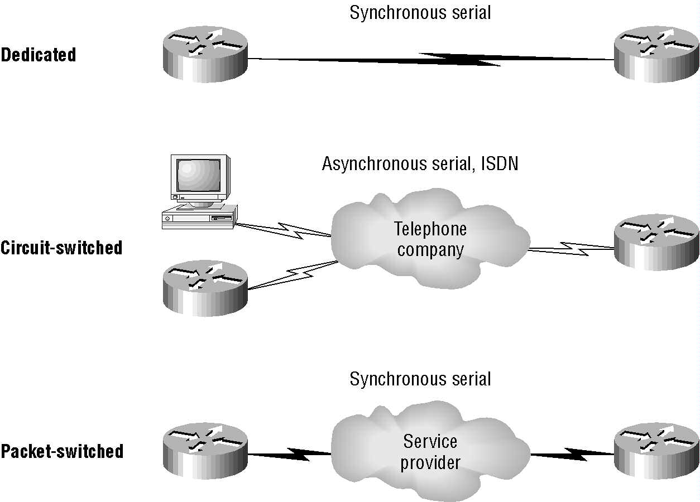
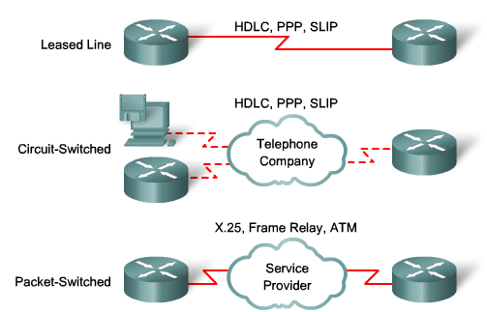
WAN Connection Types
WAN Data Link
Protocolos
Each WAN connection type uses a Data Link layer protocol to encapsulate a packet while it is crossing the WAN link.
The choice of encapsulation protocols depends on the WAN technology and the equipment.
Notes:
Serial Point to Point Link:
One sender, one receiver, one link, serial transmission.
Serial Link
WAN technologies are based on serial transmission at the physical layer.
There are many different serial communication standards, each one using a different signaling method.
There are three important serial communication standards affecting LAN-to-WAN connections:
V.35, RS-232, and HSSI
The standard usually defines signal levels, maximum bandwidth, connector pin-out, and electrical characteristics of the serial lines.
Asynchronous Transmission:
Transmitting & Receiving devices maintain their own internal clocks. They do not synchronize their clocks before communicating.
data is transmitted in well-defined frames.
The frame includes both information (e.g., data) and overhead (e.g. control bits).
Each frame begins with a start bit & ends with a stop bit.
Synchronous Transmission:
Transmitting device provides clocking.
May use separate channel that is dedicated to the clock
The clock signal acts a control line that tells the receiver when to read from the data line.
What this means is that the transmitter and receiver must synchronize their access to the data line in order to successfully transmit data.
Synchronous transmission advantages:
1. Lower overhead and thus, greater throughput
Synchronous transmission disadvantages:
1. Slightly more complex
2. Hardware is more expensive…
Asynchronous transmission advantages:
1. Simple, doesn’t require synchronization of both communication sides
2. Cheap, timing is not as critical as for synchronous transmission, therefore hardware can be made cheaper
Asynchronous transmission disadvantages:
1. Large relative overhead, a high proportion of the transmitted bits are uniquely for control purposes and thus carry no useful information

Slide 6
HDLC

Slide 7
HDLC
High-level Data Link Control (HDLC) is one of the oldest data link layer protocols for the WAN developed by the ISO.
HDLC is a bit-oriented protocol for communication over point-to-point and multipoint links.
Although HDLC can be used for point-to-multipoint connections, the most common usage of HDLC is for point-to-point serial communications.
It supports full-duplex communication.

Slide 8
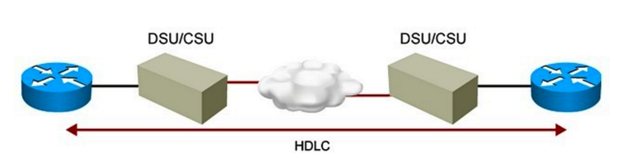
HDLC
The protocol uses the services of a physical layer, and provides either a best effort or reliable communications path between the transmitter and receiver (i.e. with acknowledged data transfer).
No authentication can be used with HDLC.
Many protocol suites use an HDLC (or HDLC-based) link layer, including X.25, the IP point-to-point protocol (PPP) and SNA.

Slide 9
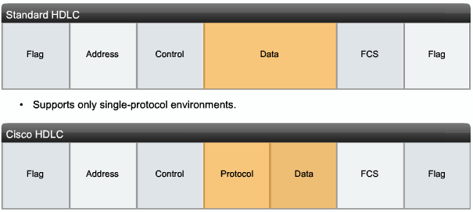
HDLC Encapsulation
HDLC defines a Layer 2 framing structure that allows for flow control and error control through the use of acknowledgments (just on multipoint).
Each frame has the same format, whether it is a data frame or a control frame.

Slide 10
HDLC Encapsulation
Flag :
The frame always starts and ends with an 8-bit Flag field.
The bit pattern is 01111110.
The Flag field initiates and terminates error checking.
Transparency
The flag sequence must never occur within the content of a frame.
A technique known as 0-bit insertion (bit stuffing) is used to prevent random data synthesizing a flag.
This technique make HDLC transparent, since any stream of bits may be present between the open and closing flag of a frame.
The receiving system strips out the inserted bits.
When frames are transmitted consecutively, the end flag of the first frame is used as the start flag of the next frame.
Notes:
The flag sequence must never occur within the content of a frame otherwise it could be confused with an intentionally sent flag.
Because there is a likelihood that this pattern occurs in the actual data, the sending HDLC system always inserts a 0 bit after every five consecutive 1s in the data field, so in practice the flag sequence can only occur at the frame ends.

Slide 11
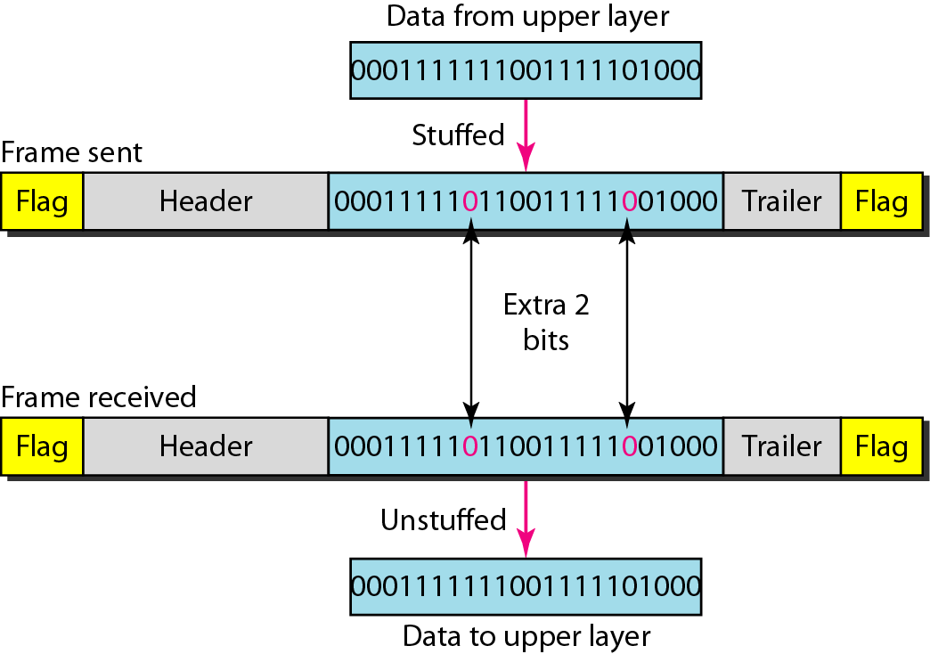
Bit stuffing
Bit stuffing is the process of adding one extra 0 whenever five consecutive 1s follow a 0 in the data, so that the receiver does not mistake the pattern 0111110 for a flag.

Slide 12
HDLC Encapsulation
Address:
This field is not needed for point-to-point links, but is always included for the sake of uniformity.
Control Field:
It defines the three types of frames I,U and S Frame for HDLC.
Frame Check Sequence (FCS)
Is usually a cyclic redundancy check (CRC) calculation remainder.
The CRC calculation is redone in the receiver. If the result differs from the value in the original frame, an error is assumed.
Notes:
Address:
The address field identifies the secondary station that transmitted or is to receive the frame.

Slide 13
HDLC Encapsulation
HDLC was not intended to encapsulate multiple Network layer protocols across the same link.
The HDLC header carries no identification of the type of protocol being carried inside the HDLC encapsulation.
Because of this, each vendor that uses HDLC has their own way of identifying the Network layer protocol, which means that each vendor’s HDLC is proprietary for their equipment

Slide 14
CHDLC
Cisco has developed an extension to the HDLC protocol (Cisco HLDC (CHDLC) )to solve the inability to provide multiprotocol support,.
CHDLC frames contain a field for identifying the network protocol being encapsulated.

Slide 15
PPP Protocol

Slide 16
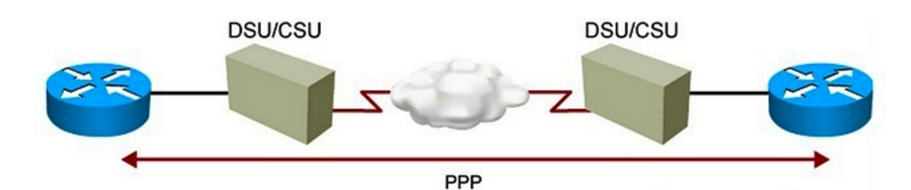
PPP
Point-to-Point Protocol (PPP) is the name of a single protocol, whereas the “PPP” can be used to refer to the entire suite of protocols that are related to PPP.
The PPP protocol was developed by IETF as a means of transmitting data for more than one network protocol over the same point-to-point serial link in a standard, vendor-independent way.
It can carry IP, Novell IPX, AppleTalk, and DECnet traffic.

Slide 17
PPP
PPP also offers many features that HDLC does not including the following:
Authentication through the Password Authentication Protocol (PAP) and the Challenge-Handshake Authentication Protocol (CHAP)
Compression capabilities with Stacker or Predictor
PPP Multilink, the ability to bundle physical channels into a single logical channel.
Support for Error detection and error recovery features
Encapsulation for multiple routed protocols, including IP, Novell IPX, and AppleTalk

Slide 18
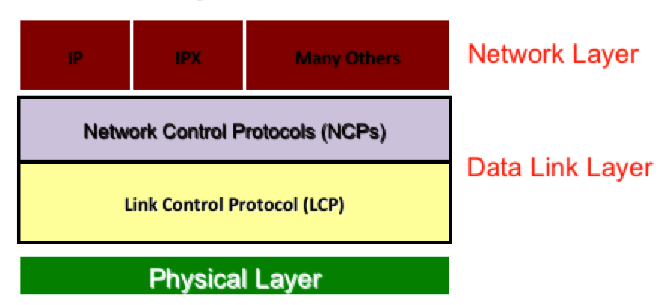
PPP
PPP is a layered protocol, starting with a Link Control Protocol (LCP) for link establishment, configuration and testing. Once the LCP is initialized, one or many of several Network Control Protocols (NCPs) can be used to transport traffic for a particular protocol suite.
Notes:
In terms of the architecture and frame formats, PPP can be seen as three different sub-protocols, for framing and lower level capabilities; it is basically HDLC. If you see the frame formats, it is very similar to HDLC. One sub-layer above is LCP, which provides all of the additional functionality in terms of authentication, multilink, and the general establishment configuration and testing of the data link connection. A third protocol is NCP; it is used for establishing and configuring different network layer protocols. It is basically the interface toward the upper layers.

Slide 19
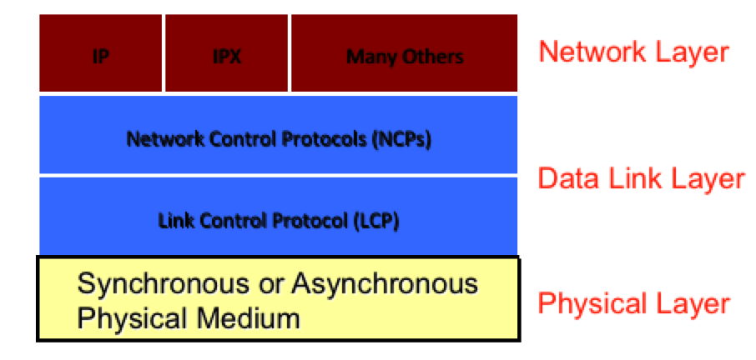
PPP and PHY Layer
PPP operates at the Data Link layer.
At the physical layer, PPP can be used across synchronous (e.g., ISDN, leased lines) and asynchronous (e.g., modem dialup) data links.

Slide 20
HOW PPP Work
The mechanism that PPP uses to carry network traffic is to open a link with a short exchange of packets.
Once the link is open, network traffic is carried with very little overhead. Frames are sent as unnumbered information frames, meaning that no data link acknowledgement is required and no retransmissions are carried out.
So once the link is established, PPP acts as a straight data pipe for protocols.

Slide 21
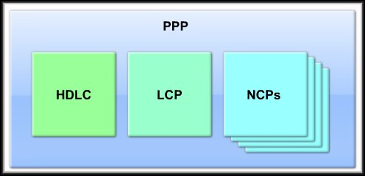
PPP Components
pap

Slide 22
PPP Components
Three main components:
LCP:
To establish, configure, maintain and terminate the data link connection.
NCPs:
Family of NCPs for establishing and configuring different network layer protocols.
Allows simultaneous use of multiple Network layer protocols
Notes:
Translation: IP and IPX and others, simultaneously, over a single dialup or higher speed WAN link.

Slide 23
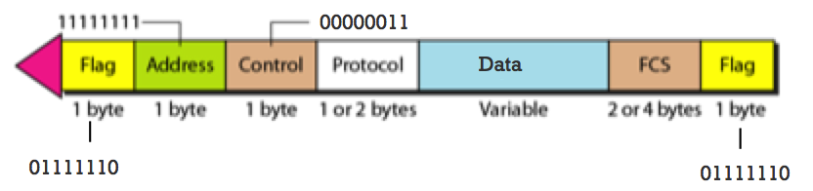
Encapsulation
PPP defines a Protocol Type field.
The protocol type field identifies the type of packet inside the frame,. The following shows a PPP frame.

Slide 24
PPP Data Frame
Flag: delimiter (framing)
Address: does nothing (only one option)
Control: does nothing; in the future possible multiple control fields
Protocol: upper layer protocol to which frame delivered (eg, PPP-LCP, IP, IPCP, etc)
Data: upper layer data being carried
FCS: cyclic redundancy check for error detection

Slide 25
Byte Stuffing
One of PPP design requirements is data transparency.
Transparency means carrying any bit pattern in the data field
data field must be allowed to include flag pattern <01111110>
Qn: is received <01111110> data or flag?
Sender: adds (“stuffs”) extra < 01111110> byte after each < 01111110> data byte
Receiver:
two 01111110 bytes in a row: discard first byte, continue data reception
single 01111110: flag byte

Slide 26
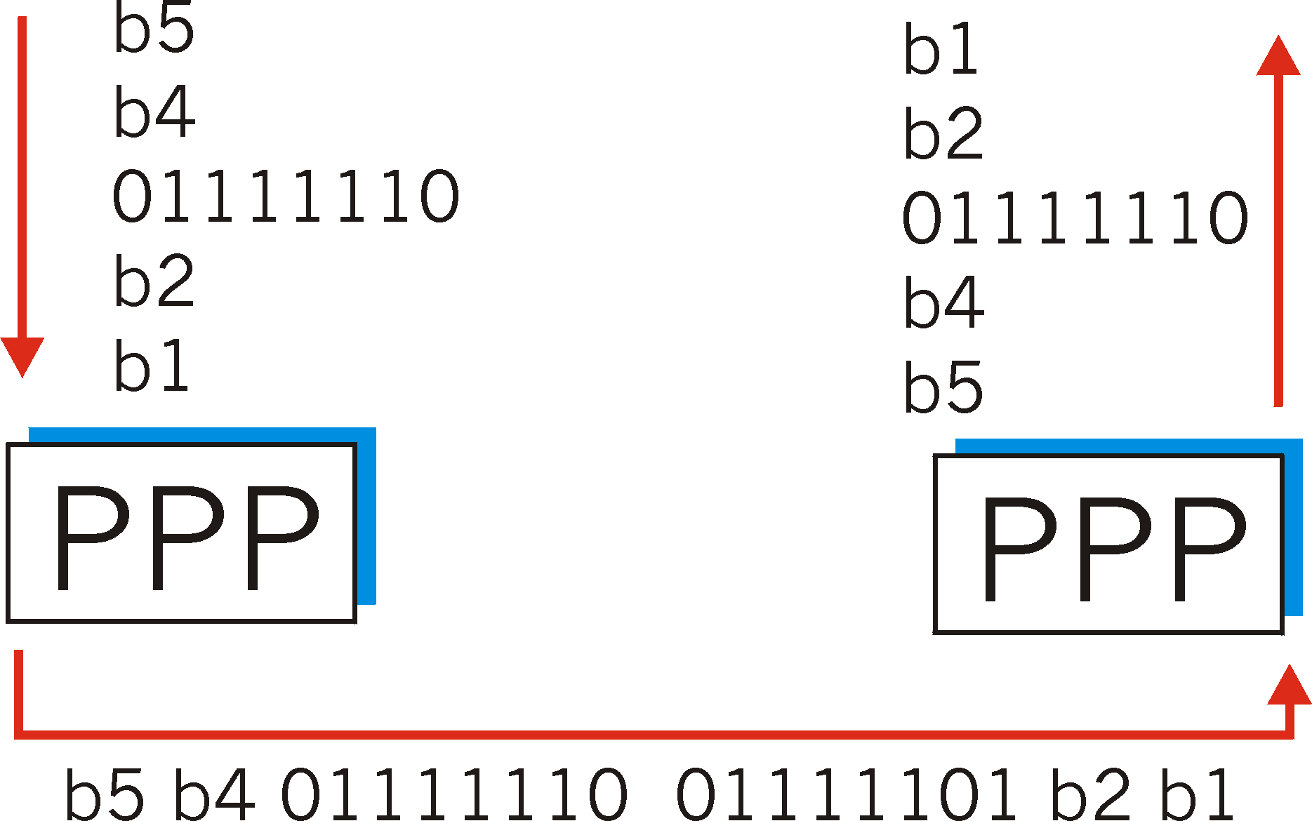
Byte Stuffing
flag byte
pattern
in data
to send
flag byte pattern plus
stuffed byte in transmitted data

Slide 27
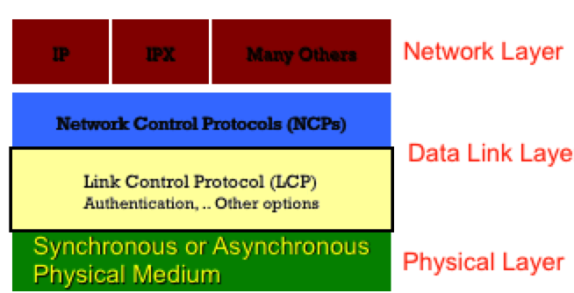
LCP
Link establish: The process of bringing up the PPP link before any other protocols can begin transmission.
Link configuration: The process of negotiating and setting up the parameters of a link.
Link maintenance: The process of managing an opened link.
Link termination: The process of closing an existing link when it is no longer needed (or when the underlying physical layer connection closes).

Slide 28
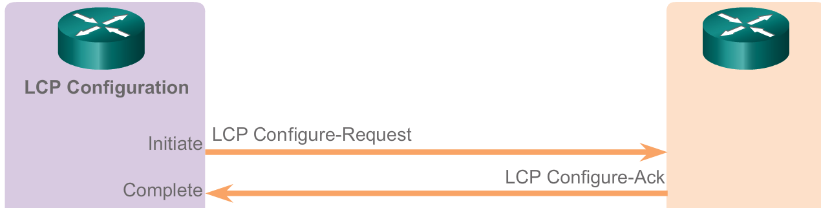
LCP
In link configuration, LCP frames are exchanged that enable the two physically-connected devices to negotiate the parameters (configuration options) under which the link will operate.
Device1 sends a configure request frame, containing configuration options.
Device2 responds with a frame confirming that the options are okay, suggesting different options or rejecting the options.
Configure-nak
Configure-reject
Notes:
This exchange takes place in both directions and when a station has sent and received an acknowledge packet the link layer is declared open.
The other device (let's call it sayâ€¦ device B J) receives the Configure-Request and processes it. It then has three choices of how to respond:
If every option in it is acceptable in every way, device B sends back a Configure-Ack (â€œacknowledgeâ€). The negotiation is complete.
If all the options that device A sent are valid ones that device B recognizes and is capable of negotiating, but it doesn't accept the values device A sent, then device B returns a Configure-Nak (â€œnegative acknowledgeâ€) frame. This message includes a copy of each configuration option that B found unacceptable.
If any of the options that A sent were either unrecognized by B, or represent ways of using the link that B considers not only unacceptable but not even subject to negotiation, it returns a Configure-Reject containing each of the objectionable options.

Slide 29
LCP Configuration Options
LCP offers PPP different options, including the following:
Maximum-Receive-Unit (MRU): Lets a device specify the maximum size datagram it wants the link to be able to carry.
Authentication-Protocol: the device can indicate the type of authentication protocol it wishes to use (if any).
Compression: Allows the device to specify that it wants to use a compression. This is used to increase the throughput of PPP connections
Quality-Protocol: If the device wants to enable quality monitoring on the link, what protocol to use
Other options: Error detection, Magic Number, Multilink

Slide 30
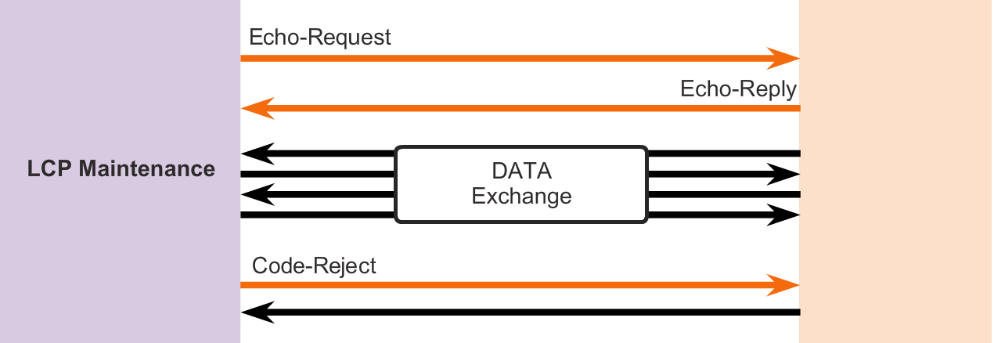
LCP
During link maintenance, LCP can use messages to provide feedback and test the link
Echo-Request, Echo-Reply, and Discard-Request - These frames can be used for testing the link.
Code-Reject and Protocol-Reject - These frame types provide feedback when one device receives an invalid frame due to either an unrecognized LCP code (LCP frame type) or a bad protocol identifier.

Slide 31
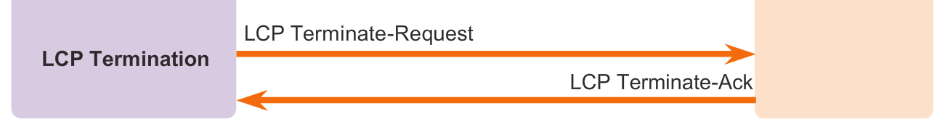
LCP
The LCP closes the link by exchanging Terminate packets.
A termination request indicates that the device sending it needs to close the link.
When the link is closing, PPP informs the network layer protocols so that they may take appropriate action.
Notes:
PPP can terminate the link at any time. This might happen because of the loss of the carrier, authentication failure, link quality failure, the expiration of an idle-period timer, or the administrative closing of the link.
The device initiating the shutdown (which may not be the one that initiated the link in the first place) sends a Terminate-Request message. The other device replies back with a Terminate-Ack.

Slide 32
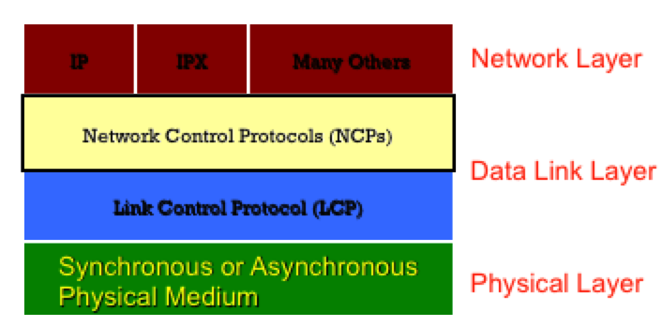
NCP
PPP use the NCP to permit multiple network layer protocols to operate on the same communications link.

Slide 33
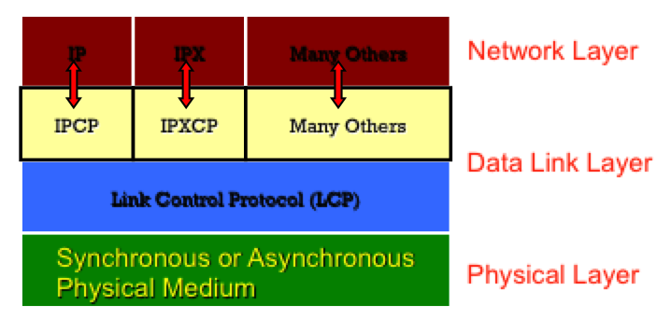
NCP
For every network layer protocol used, PPP uses a separate NCP. For example, IPv4 uses the IP Control Protocol (IPCP) and IPv6 uses IPv6 Control Protocol (IPv6CP).

Slide 34
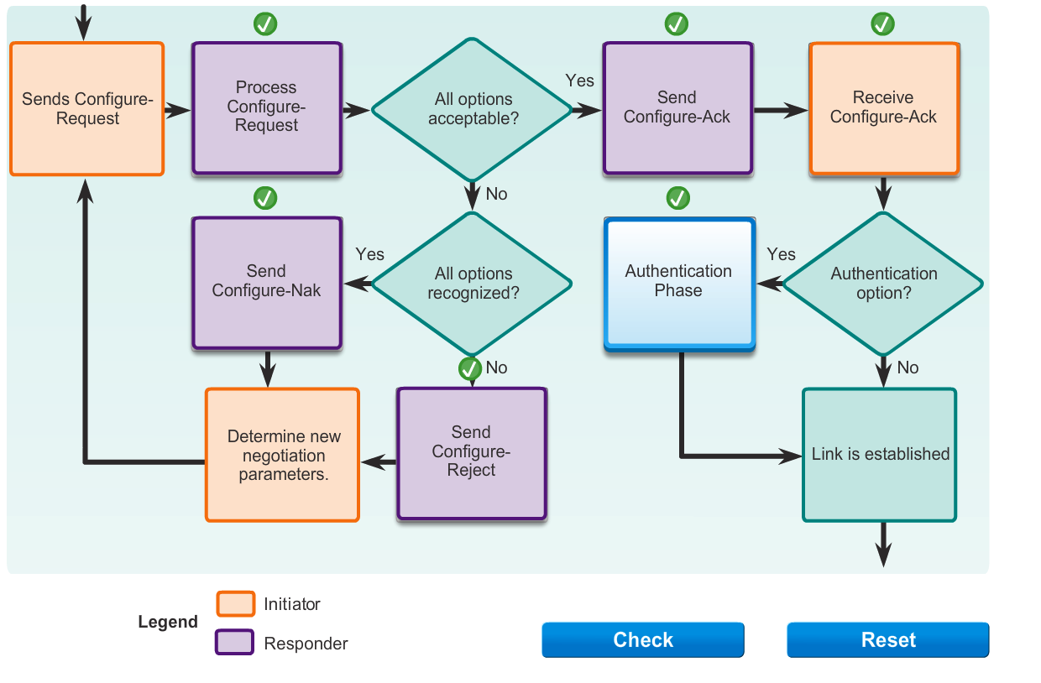

Slide 35
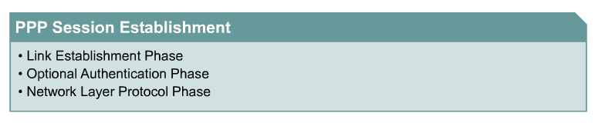
PPP Session Establishment
PPP session establishment progresses through three phases:
link establishment
authentication
network layer protocol phase

Slide 36
PPP Session Establishment (Detail)
1. Link establishment - (LCPs)
2. Authentication - Optional (LCPs)
3. Link quality determination - Optional (LCPs)
4. Network layer protocol configuration (NCPs)
5. Link termination (LCPs)

Slide 37
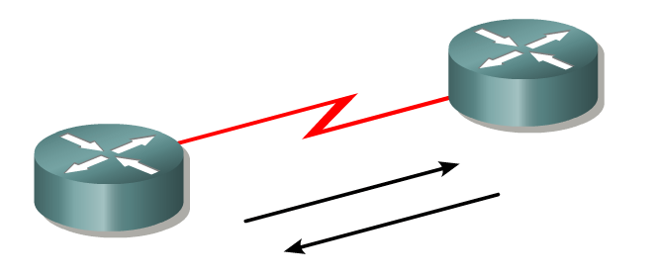
1- Link-establishment phase
Before any network layer packets can be exchanged, LCP must first open the connection and negotiate the configuration parameters.
In this phase each PPP device sends LCP frames to configure the data link.
LCP frames contain a configuration option field that allows devices to negotiate the use of options such as the maximum transmission unit (MTU), compression of certain PPP fields, and the link-authentication protocol.
If a configuration option is not included in an LCP packet, the default value for that configuration option is assumed.
This phase is complete when a configuration acknowledgment frame has been sent and received.

Slide 38
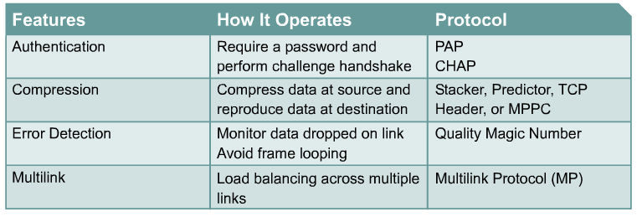
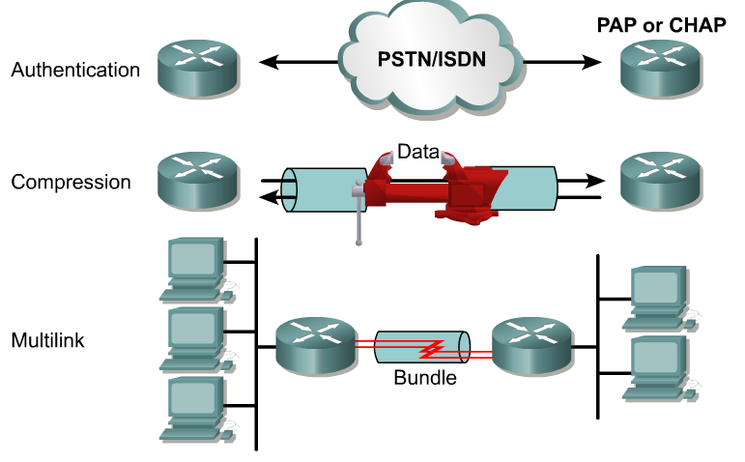

Slide 39

PPP Multilink (MLP)
In some environments, it may be necessary to bundle multiple serial links to act as single link with aggregated bandwidth.
PPP Multilink is common with ISDN.

Slide 40
Compression
Point-to-point software compression can be configured on serial interfaces that use PPP encapsulation.
Compression is performed in software and might significantly affect system performance because it is software, not hardware compression.
Compression can be CPU or memory intensive.

Slide 41
Error Detection
Link Quality Monitoring (LQM) is available on all serial interfaces running PPP.
LQM will monitor the link quality, and if the quality drops below a configured percentage, the link will be taken down.
The percentages are calculated for both the incoming and outgoing directions.

Slide 42
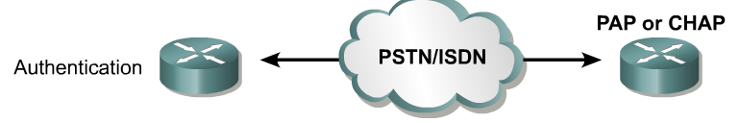
2- Authentication Phase (Optional)
After the link has been established and the authentication protocol decided on, the peer may be authenticated.
Authentication, if used, takes place before the network layer protocol phase is entered.
As part of this phase, LCP also allows for an optional link-quality determination test.
The link is tested to determine whether the link quality is good enough to bring up network layer protocols

Slide 43
Authentication
Authentication is a mechanism used to verify the identity of another device.
This identity verification is needed to confirm that the other device is legitimate and not some one only appearing to be an authentic device in order to cause damage or steal information.
PPP defines two authentication protocols:
Password Authentication Protocol (PAP)
Channel Handshake Authentication Protocol (CHAP).

Slide 44
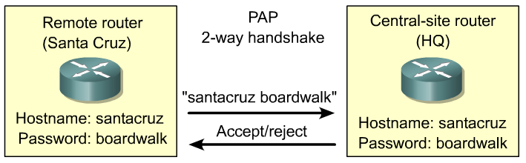
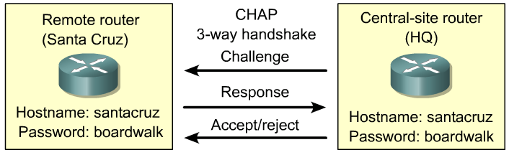
PPP authentication protocols
Both protocols involve exchanges of messages between the two PPP devices, but there are differences in detail.

Slide 45
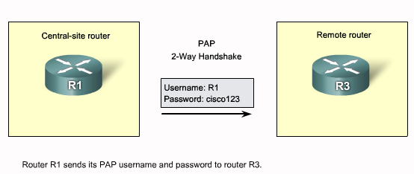
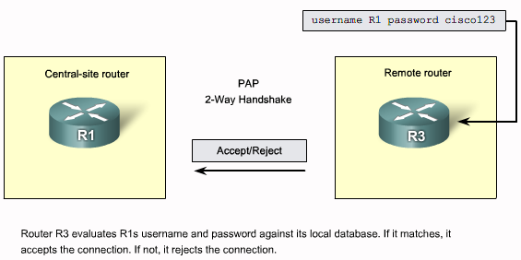
PAP
Notes:
With PAP, the device to be authenticated starts the message exchange by sending a clear text password, claiming to be legitimate.
The device at the other end of PPP link compares the password with its own password and if the password is correct, sends back an acknowledgement.
The authentication process is one way and one or both devices can authenticate each other separately.
PAP is simple in operation as well as configuration but it is insecure because the password is sent in clear text and can be sniffed.

Slide 46
Password Authentication Protocol (PAP)
PAP provides a simple method for a remote node to establish its identity, using a two-way handshake.
The authentication process is one way authentication method and one or both devices can authenticate each other separately.
PAP is not a strong authentication protocol.
Passwords are sent across the link in clear text and there is no protection from playback or repeated trial-and-error attacks.
Notes:
After the PPP link establishment phase is complete, a username/password pair is repeatedly sent by the remote node across the link until authentication is acknowledged or the connection is terminated.

Slide 47
CHAP

Slide 48
CHAP
CHAP uses a three-way handshake to verify the identity of the remote node.
After the PPP link establishment phase is complete, the local router sends a "challenge" message to the remote node.
The remote node responds with a value calculated using a one-way hash function, which is typically Message Digest 5 (MD5).
This response is based on the password and challenge message.
The local router checks the response against its own calculation of the expected hash value.
If the values match, the authentication is acknowledged, otherwise the connection is immediately terminated.

Slide 49
CHAP
CHAP provides protection against playback attack through the use of a variable challenge value that is unique and unpredictable.
Since the challenge is unique and random, the resulting hash value will also be unique and random.

Slide 50
3- Network Layer Protocol Phase
In this phase the PPP devices send NCP packets to choose and configure one or more network layer protocols, such as IP.
Once each of the chosen network layer protocols has been configured, packets from each network layer protocol can be sent over the link.
The PPP link remains configured for communications until LCP or NCP frames close the link.

Slide 51
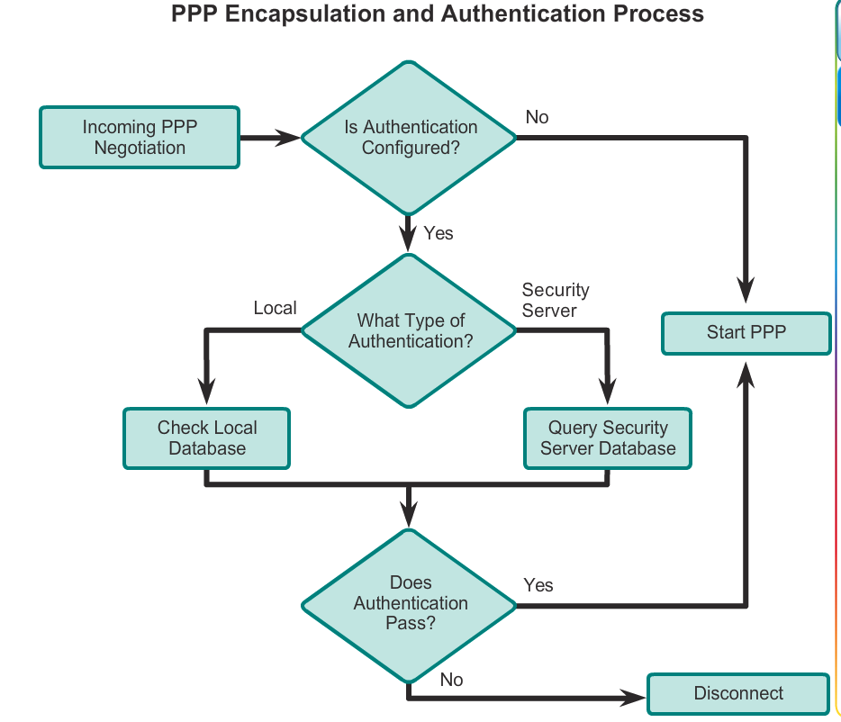
PAP
CHAP

Slide 52
